Slide 1

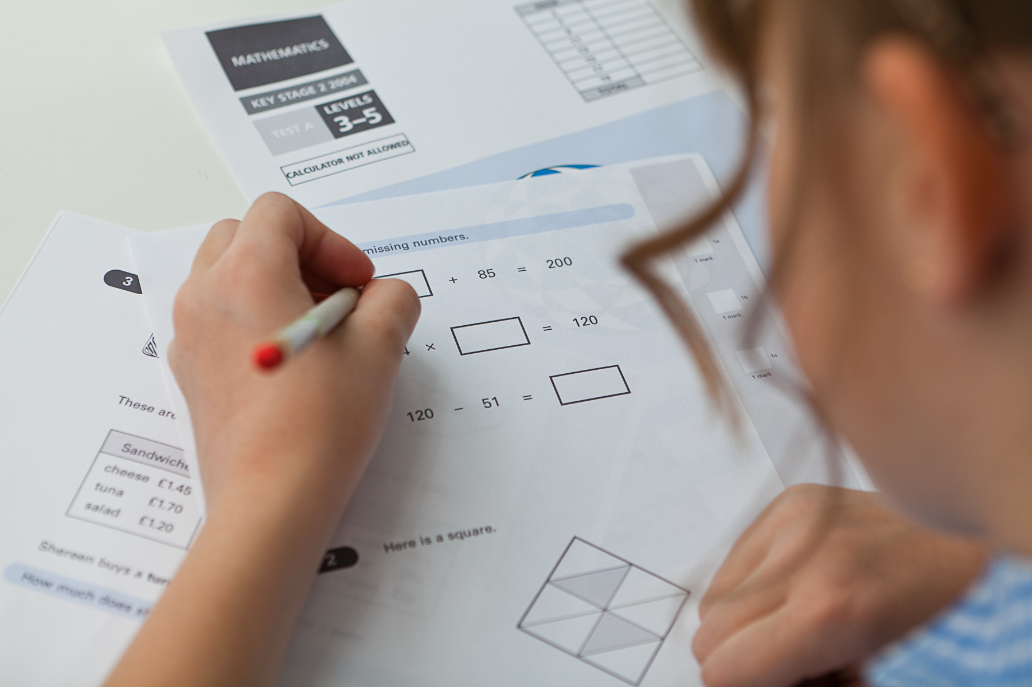
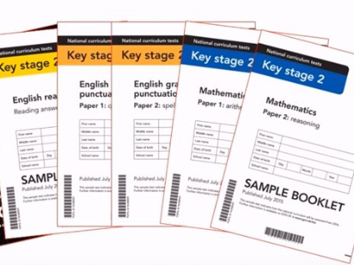

SATs Meeting 2026
21st October 2026 – 5pm

Slide 2
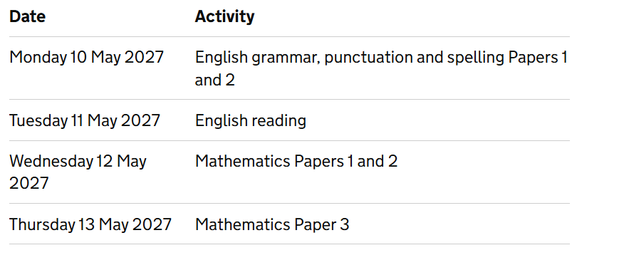
What are SATs?
SATs are the Standardised Assessment Tests that are given to children at the end of Key Stage 2. They take place over four days, starting on Monday 10th May ending on Thursday 13th May.
Writing is assessed using evidence collected throughout Year 6. There is no Year 6 SATs writing test.
Science is teacher assessed – there is no test it is based on teacher judgement across the year.

Slide 3
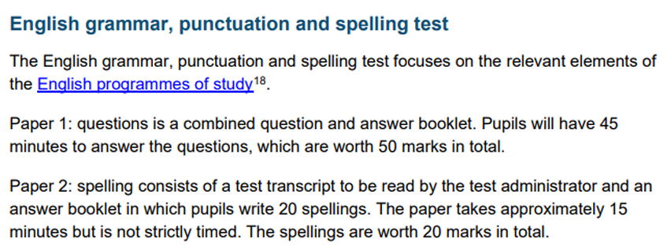
Monday 10th May - English grammar, punctuation and spelling test

Slide 4
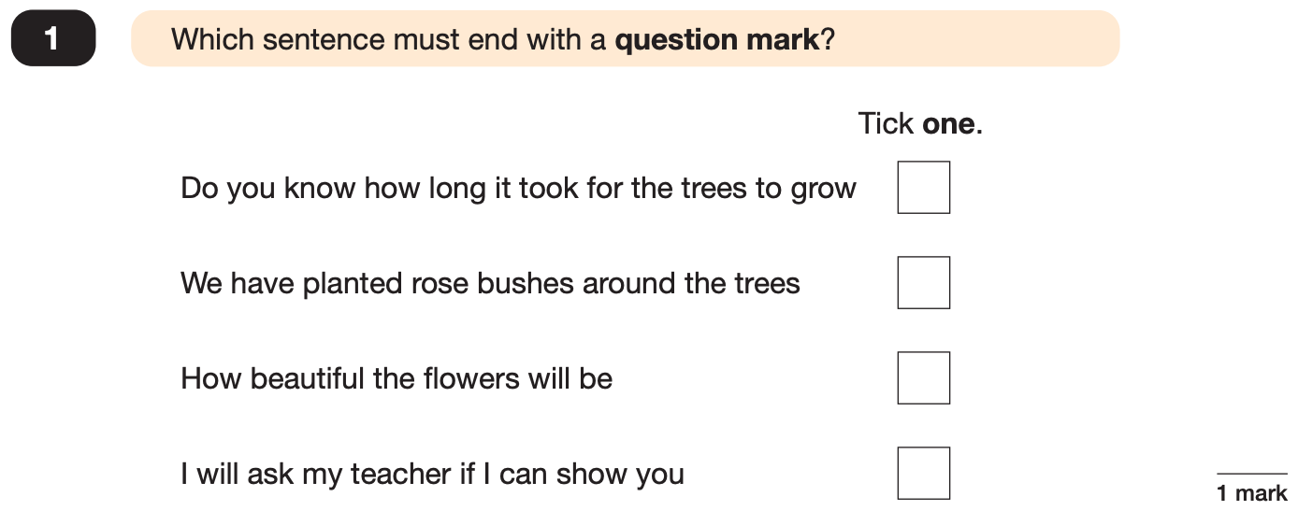
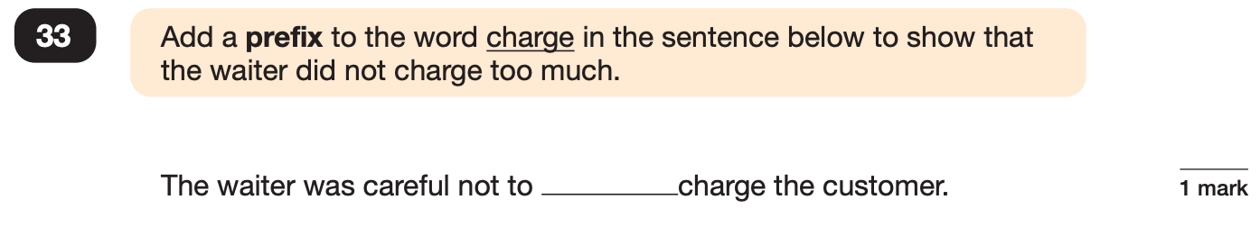
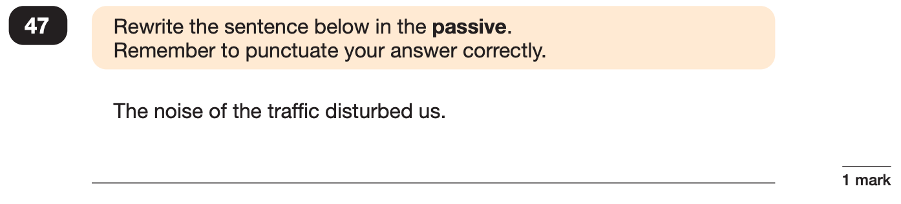
Grammar, Punctuation and Spelling: Paper 1 (GPS)
Example questions:

Slide 5
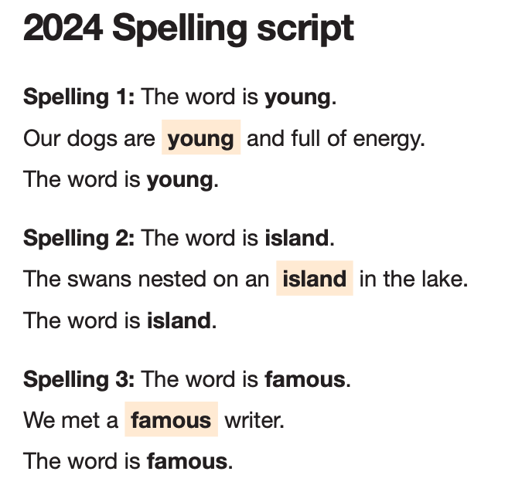
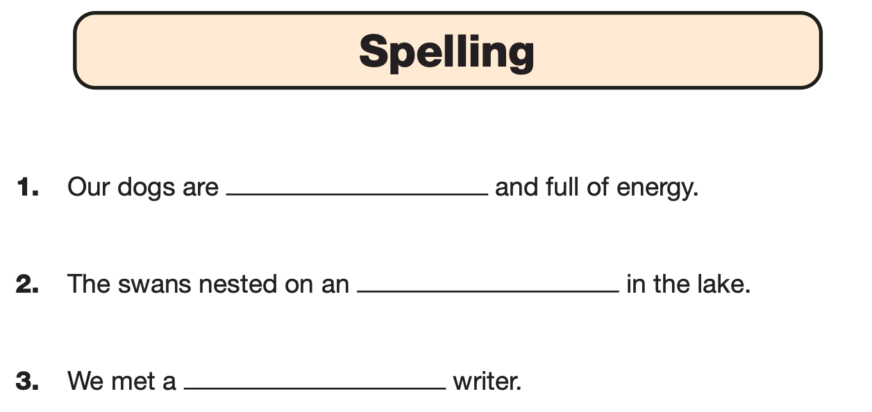
Grammar, Punctuation and Spelling: Paper 2 (spelling)
Paper 2 is a shorter paper that focuses solely on spellings.
Example questions:

Slide 6
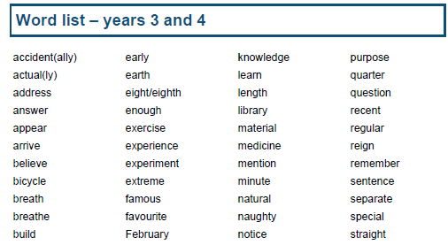
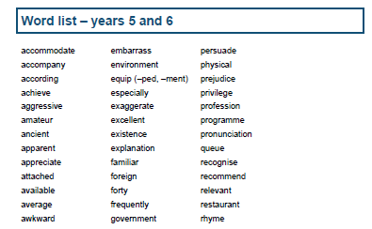
Ways you can help prepare for the SPAG test -
Recap terminology – particularly word class – What is a verb, adjective, conjunction, preposition etc.
Recap synonyms and antonyms of words – similar and opposite words.
Reminder of how to use punctuation – commas, brackets, dashes, colons, semi colons, inverted commas.

Slide 7
Tuesday 11th May – Reading test
There is one reading test that lasts for 60 minutes.
There are three different set texts for children to read. These could be any combination of non-fiction, fiction and/ or poetry.
The test covers the following areas (known as Content Domains):
Give/ explain the meaning of words in context;
Retrieve and record information/ identify key details from fiction and non-fiction;
Summarise main ideas from more than one paragraph;
Make inferences from the text/ explain and justify inferences with evidence from the text;
Predict what might happen from details stated and implied;
Identify/ explain how information/ narrative content is related and contributes to meaning as a whole;
Identify/ explain how meaning is enhanced through choice of words and phrases;
Make comparisons within the text.

Slide 8
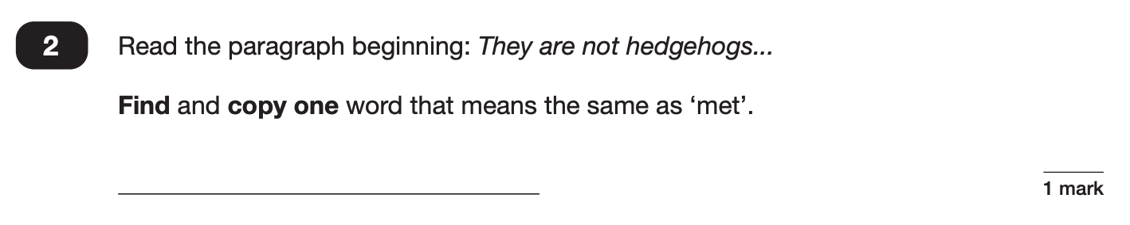

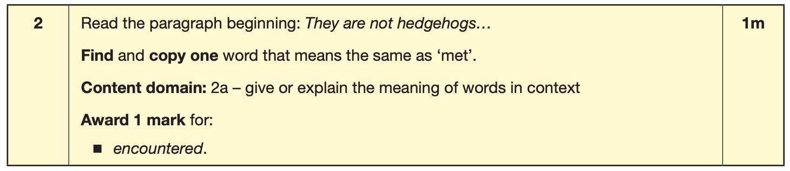
The reading SATs paper requires a range of answer styles.
Example questions:

Slide 9
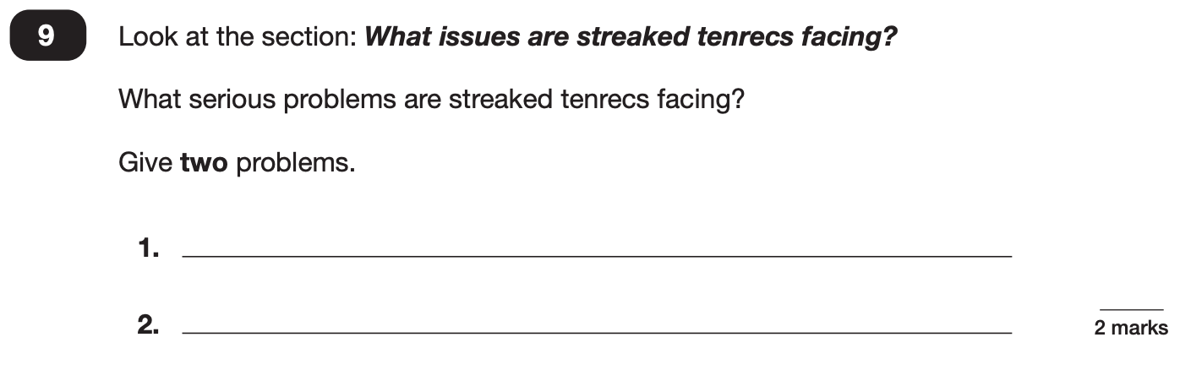
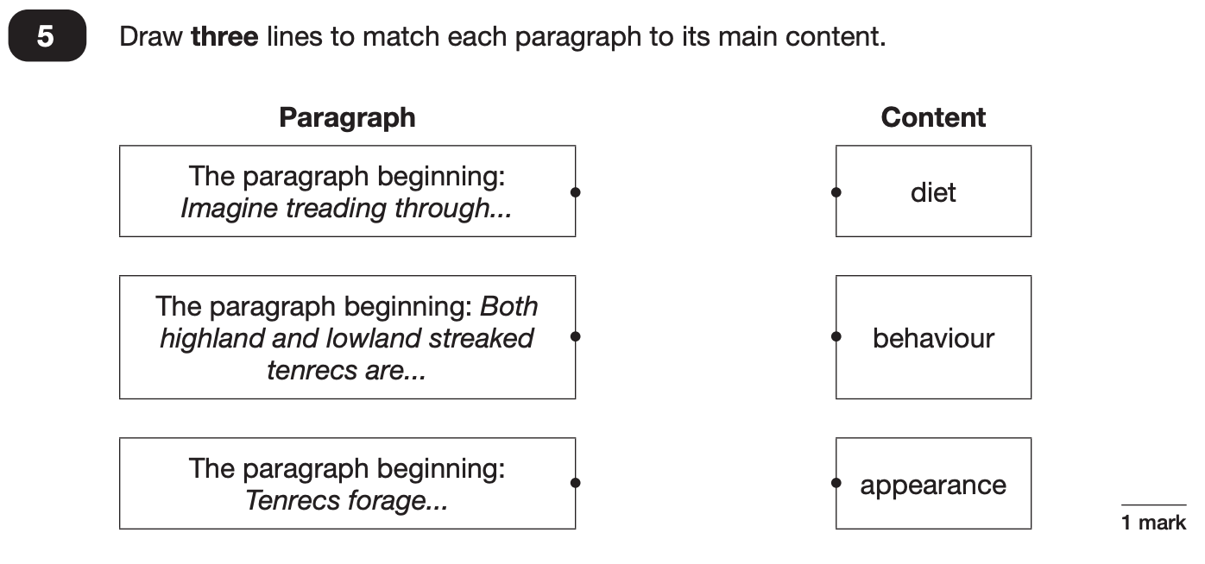
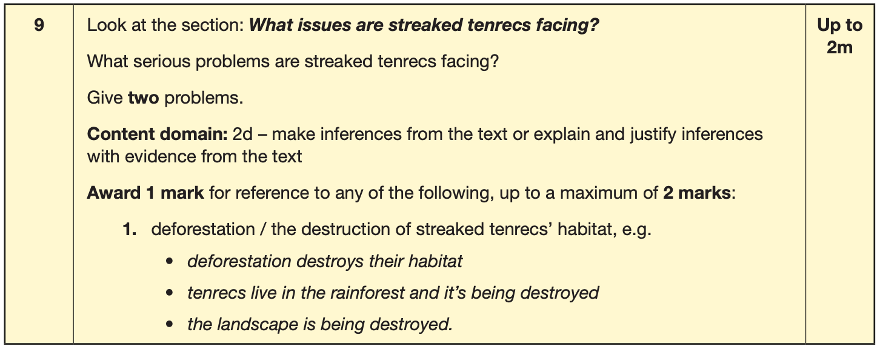
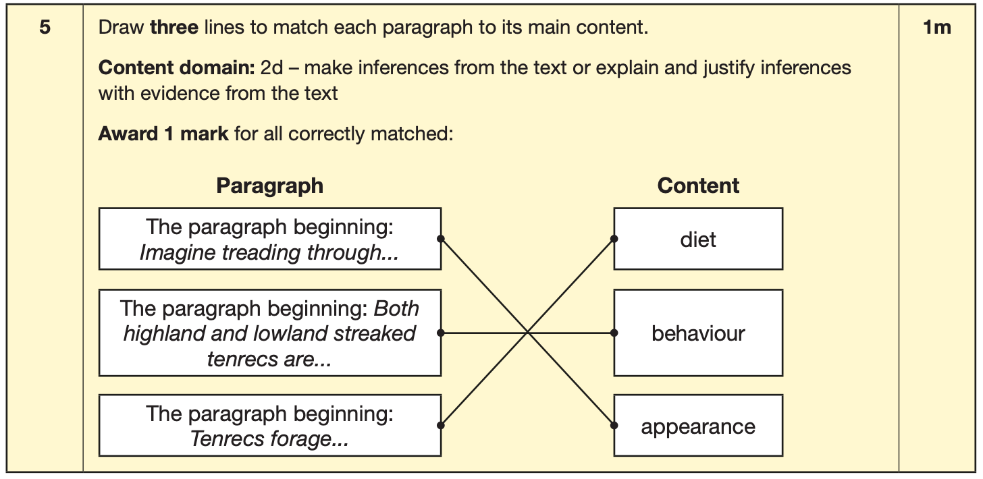

Slide 10
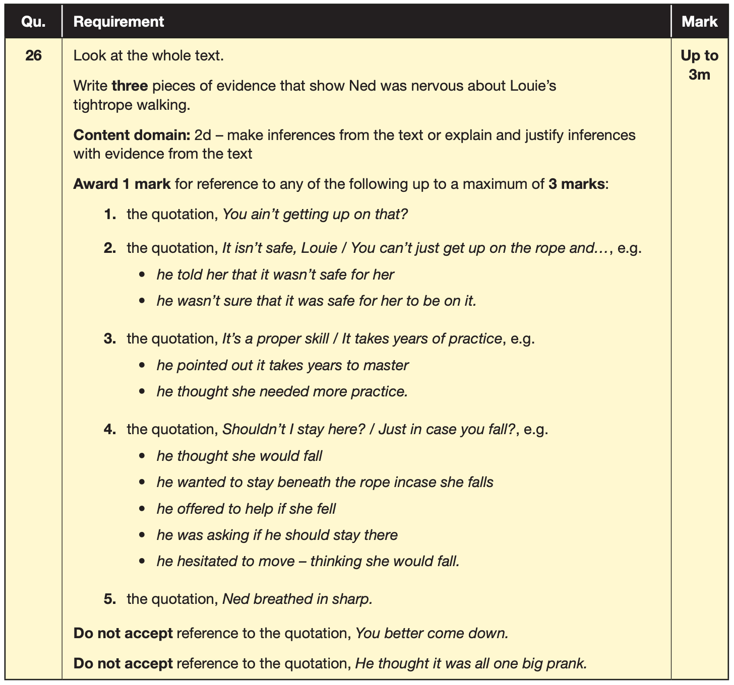
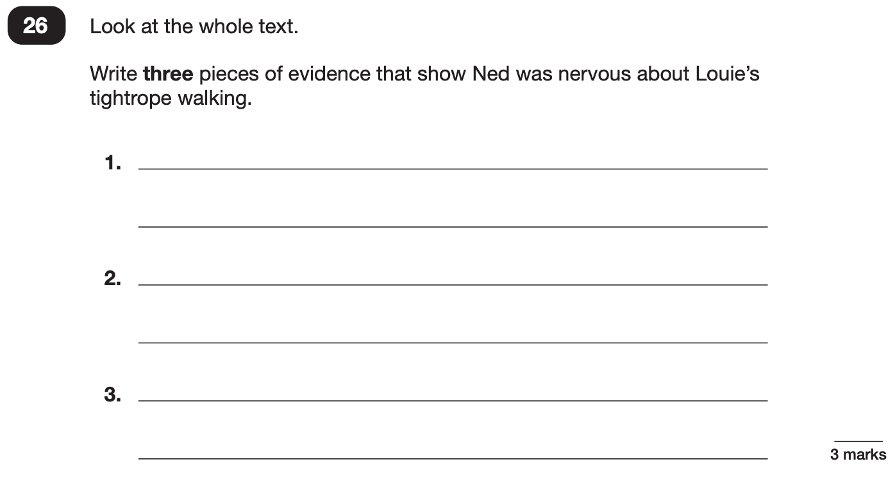
Example questions:
3 mark question

Slide 11
Ways you can help prepare for the reading test -
Example questions to ask at home when reading -
What does this word mean?
Which word in this paragraph is the closest in meaning to…?
What [character] doing when [event] happened?
True or false questions about a paragraph/ text.
Why do you [character] did [event]? Can you think of another reason?
Find evidence to suggest [character’s] personality.
Practice fluency – reading in a timely manner – 3 texts to read in a short period of time.
Test technique – circle, underline key words.
Read a variety of texts – fiction, non-fiction, poetry!

Slide 12
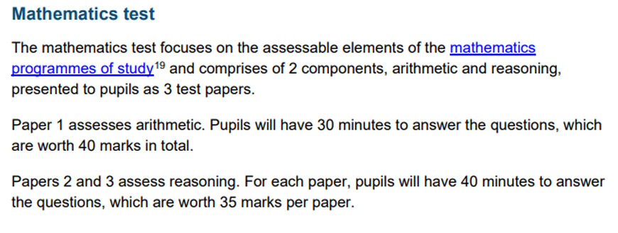
Wednesday 12th and Thursday 13th May – Mathematics test

Slide 13
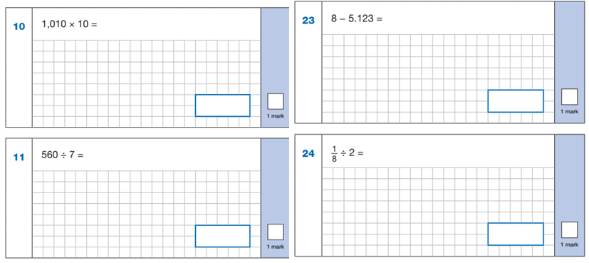
Maths paper 1 - Arithmetic
The maths arithmetic paper has a total of 40 marks and lasts for 30 minutes.
The test covers the four operations (addition, subtraction, multiplication, division, including order of operations requiring BODMAS), percentages of amounts and calculating with decimals and fractions.
Example 1 mark questions:

Slide 14
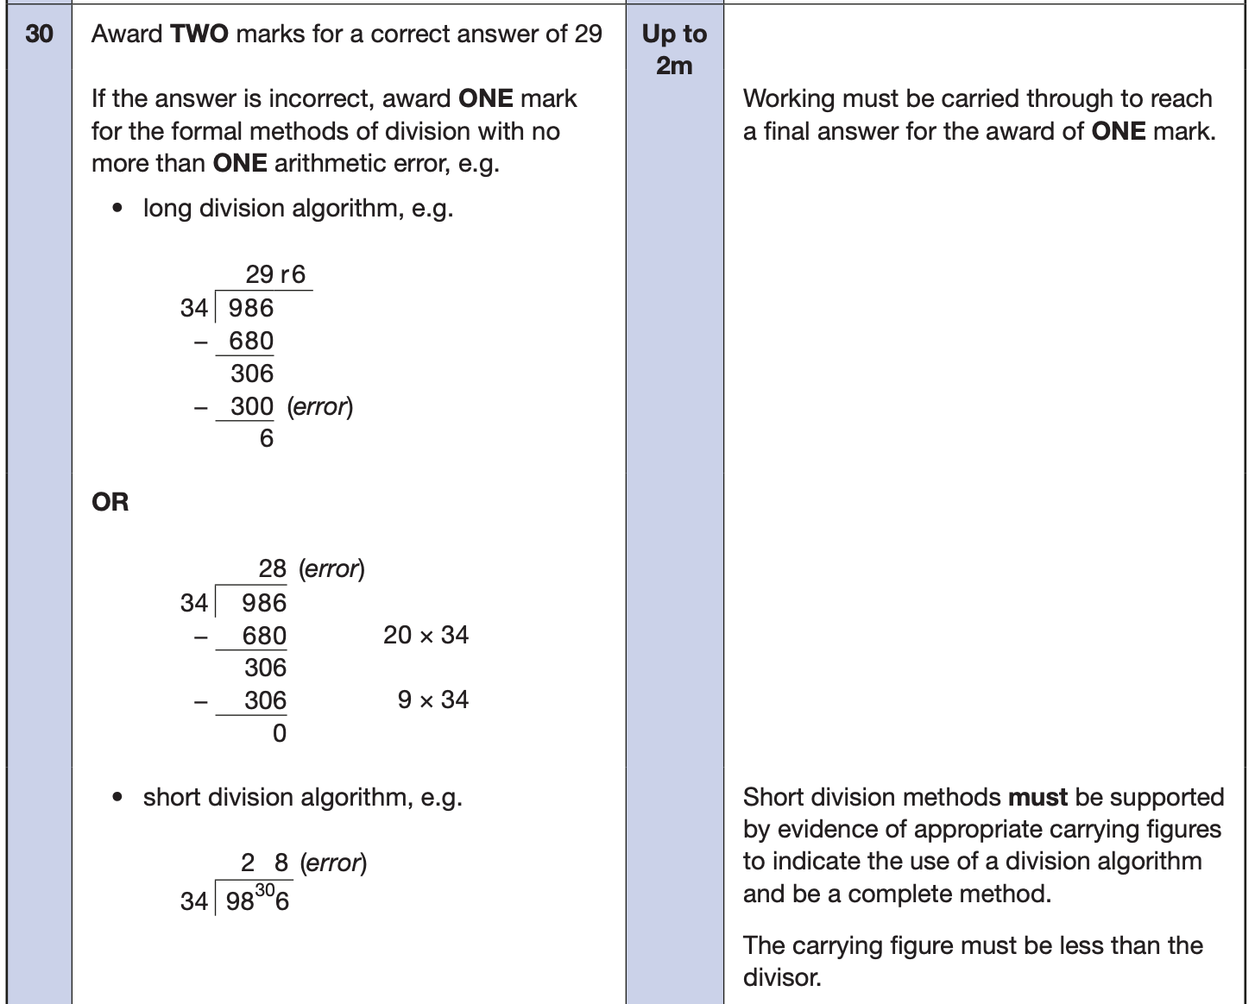
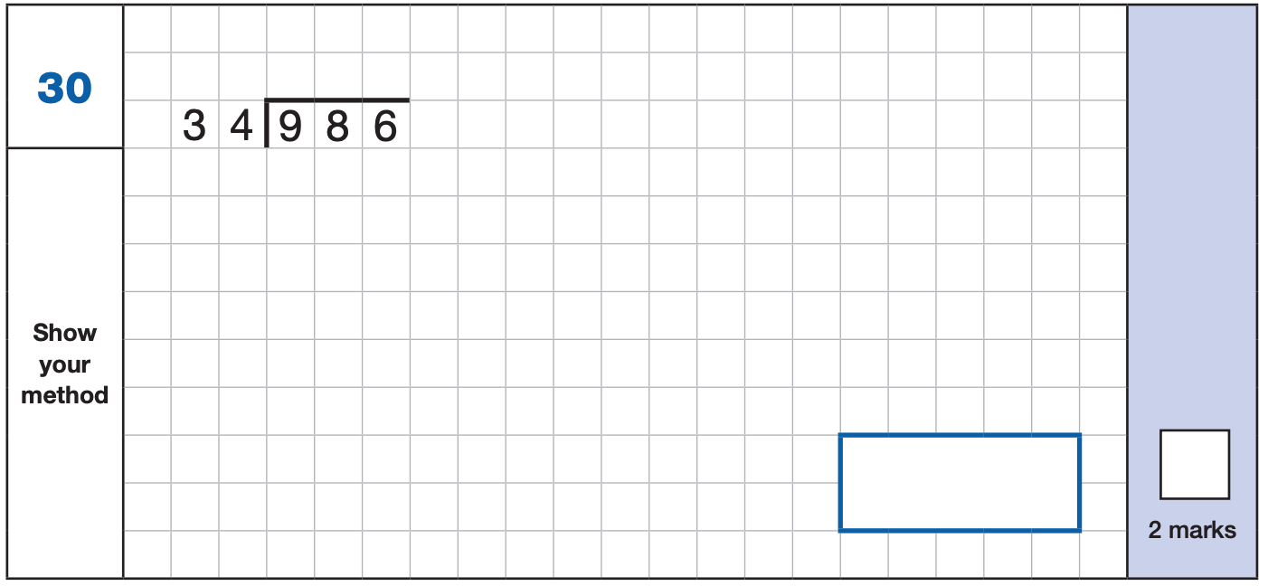
Maths paper 1 - Arithmetic
Example 2 mark question:

Slide 15
Maths Papers 2 and 3 - Reasoning
Paper 2 will take place on Wednesday 12th May and paper 3 will take place on Thursday 13th May. These tests have a total of 35 marks each and lasts for 40 minutes each.
These papers require children to demonstrate their mathematical knowledge and skills, as well as their ability to solve problems and their mathematical reasoning. They cover a wide range of mathematical topics from key stage 2 including,
Number and place value (including Roman numerals);
The four operations;
Geometry (properties of shape, position and direction);
Statistics;
Measurement (length, perimeter, mass, volume, time, money);
Algebra;
Ratio and proportion;
Fractions, decimals and percentages.

Slide 16
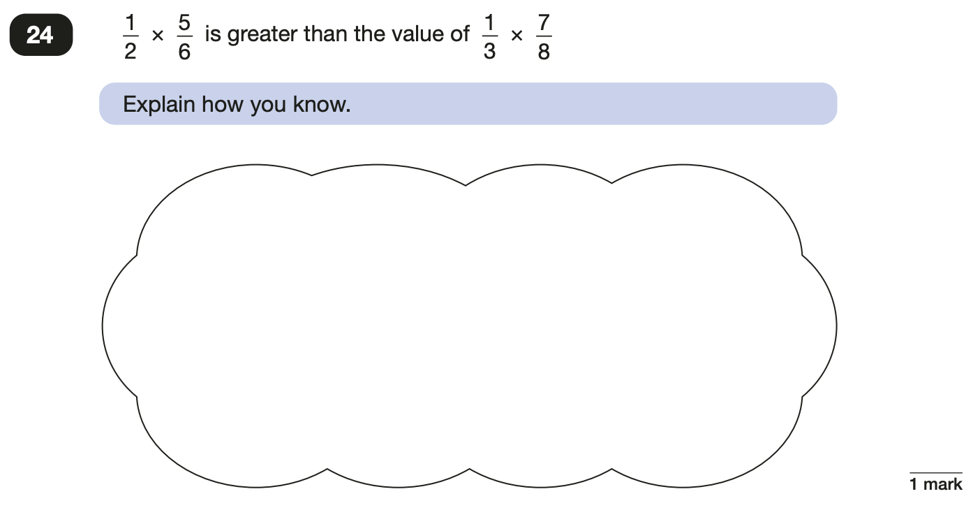
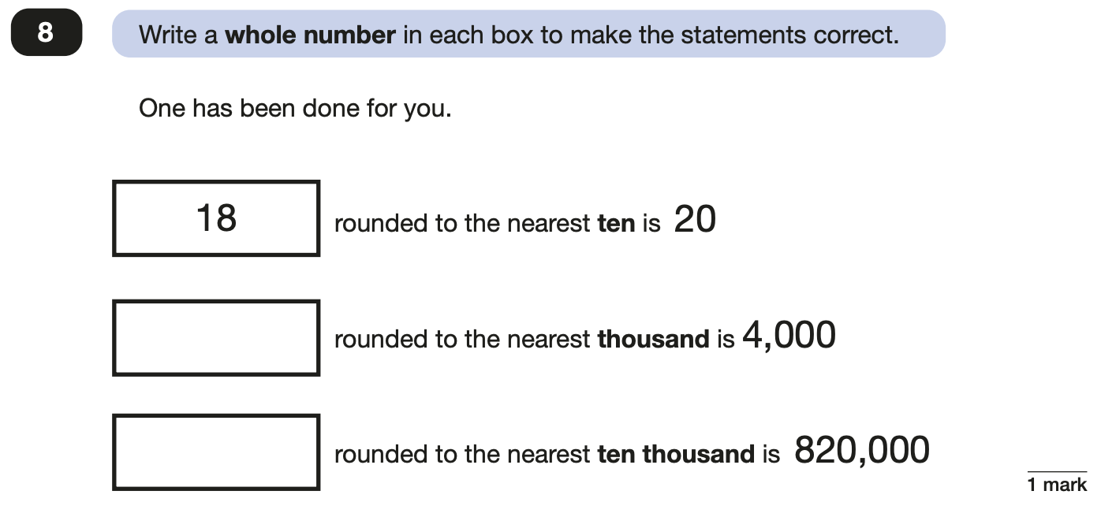
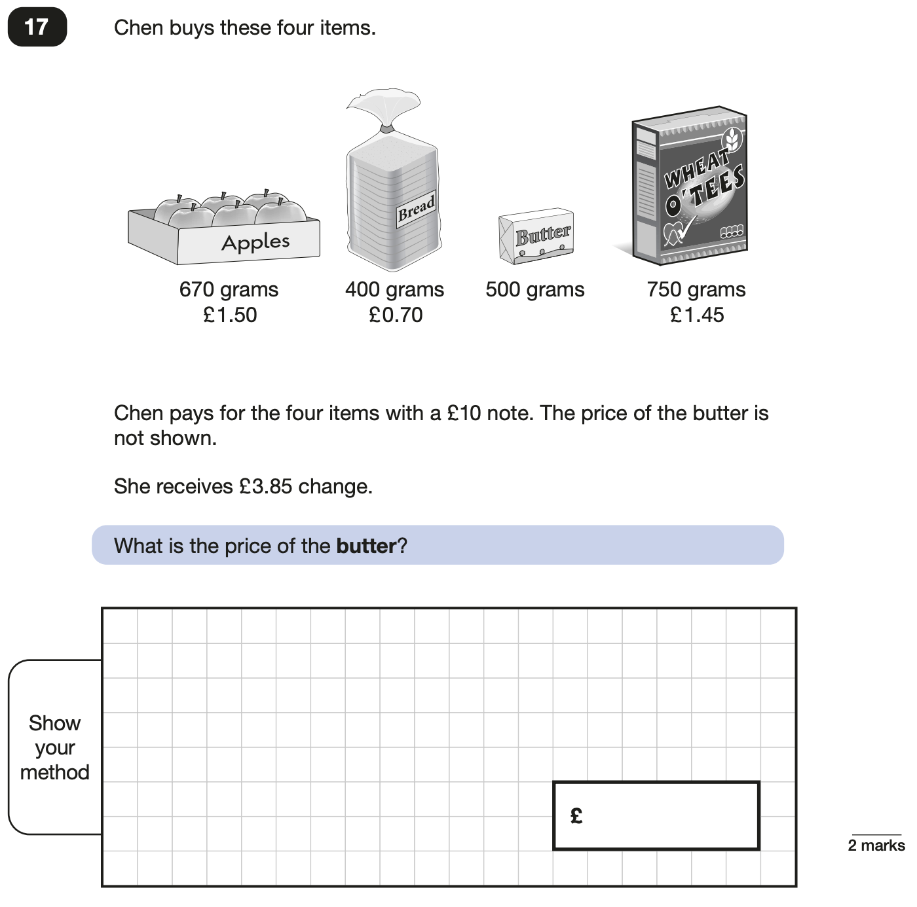
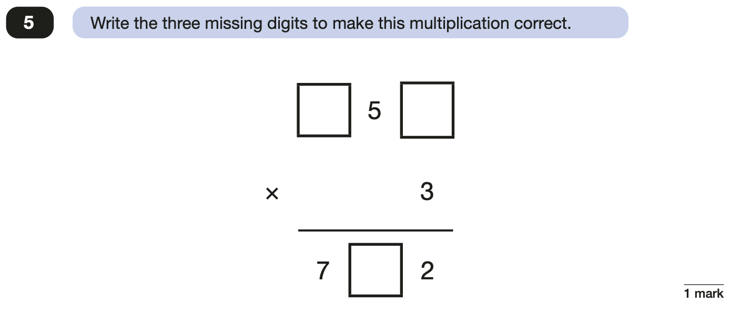
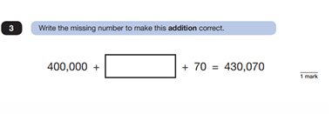
Maths Papers 2 and 3 - Reasoning

Slide 17
Ways you can help prepare for the Maths test -
Practice fluency of times tables.
Practice basics of arithmetic – multiplying and dividing by 10, 100, 1000. Formal methods – bus stop division and formal multiplication.
Practice spotting mistakes in questions – forgetting the carried numbers, reading the symbol incorrectly.
Recap – prime/composite, cube and squared numbers – what are these what do they look like.
Ensure for the reasoning that children read the question carefully – underline key information.
Advise to always show working out particularly for 2 mark questions!

Slide 18
Access arrangements – extra time and support
Applying for additional time - Schools will need to respond to each of the following 7 questions about the pupil. These questions draw on the teacher’s assessment of the pupil’s abilities or needs and do not relate to a specific diagnosis or condition. Schools should think carefully about the questions and how they relate to the pupil and must have evidence to justify their responses to the application questions in case they receive a monitoring visit.
Can the pupil understand and respond appropriately to a simple request or instruction given in English, without being prompted or aided by an interpreter or translator?
Does the pupil have a hearing impairment that prevents them from being able to respond appropriately to a simple question or instruction given in English, without being prompted or aided by a communicator, sign language interpreter or having to lip-read?
Does the pupil need braille and/or enlarged print in order to read and understand text?
Can the pupil focus on a task, which requires them to work independently and without interruption, for at least 15 minutes without being prompted to stay on task?
Is the pupil prevented from being able to write independently at a speed of more than 10 words per minute by a physical, motor skill or learning disability?
Can the pupil read age-appropriate texts aloud and fluently without making errors, or with very few errors?
Does the pupil have difficulty processing information, which prevents them from being able to answer questions on practice key stage 2 tests, even when they are allowed to refer back to the questions?
Based on the responses to the questions in the application, STA may decide the pupil qualifies for a maximum of up to 25% additional time. Children with an EHCP automatically receive 25% extra time.

Slide 19
Extra support
Scribes (where children cannot write or are known to experience fatigue)
Transcribes (where it will be difficult for the marker to read a child's writing). Children complete the test and work with the transcriber after the test is ended to transcribe answers. Transcriber must use child's original spelling.
Readers (except in the reading test)
Prompters
Rest breaks

Slide 20
Illness or injury at the time of the test
Schools should not administer a test to a pupil who is ill. If a pupil is not fit to take the test, the school should consider applying for a timetable variation for permission to administer the test on another day.
If a pupil becomes ill during a test, the school should stop the test and make a note of the time. The pupil can be given a supervised rest break in school and can continue the test with the remaining amount of time when they are feeling better. If the pupil is not able to continue, or is sent home, the partially completed test script must be sent for marking. If the pupil leaves the school premises, they will have left test conditions and must not be allowed to continue or restart the test when they return to school.
If the pupil sustains an injury that impacts their ability to write, they may use a scribe. If the injury occurred within one week of the tests, the school may also allow up to 25% additional time because the pupil is unfamiliar working with a scribe. In these situations, an application for additional time is not required. If the pupil is already familiar with working with a scribe, additional time must not be given.

Slide 21
Marking and results
SATs tests are externally marked, schools will be able to view Key Stage 2 SATs results online from Tuesday 6th July.
Parents will receive the results shortly after, this is due to us in school reviewing the papers and submitting marking review applications if we believe the marking scheme has not been applied correctly.
Parents will receive a report that includes their child's raw score, scaled score, and whether they met the national standard.
The scaled score allows for comparison with other children across the country who took the same test.
To meet government expectations, pupils must achieve 100 in their scaled scores.
A score above 100 (including 120) means that a child has exceeded the expected standard in the test.

Slide 22
Supporting your child in preparing for the SATs
Firstly, a positive attitude goes a long way. Give them as much encouragement and support as you can (but we don’t need to tell you that)!
Tips:
Don’t use past papers as they are used in school to prepare the children.
Talk to your child’s class teacher if you have any concerns rather than worry your child.
Encourage your child to talk to their teacher or a trusted adult (including yourself) about their anxieties. Don’t forget that a small amount of anxiety is normal and not harmful.
Give your child a quiet, distraction free space to complete homework or study.
Give your child time to go outside and reduce screen time.
Ensure your child is eating and drinking well and getting a good amount of sleep.
Plan something nice and fun for the weekends before and after SATs. This will help them to relax before the SATs and give them something to look forward to after.

Slide 23
Resources and Easter homework
Times table rockstars
Arithmetic and grammar practice via homework
CPG books.
Past papers are available online with mark schemes (but I don't recommend taking test after test)

Slide 24

Questions

